Slide 1


Dr. Varun.s
Dept.of. Surgery skhmc

Slide 2

 A break in the epithelial continuity
 Discontinuity of the skin or mucous membrane which occurs due to the microscopic death of the tissues

Slide 3
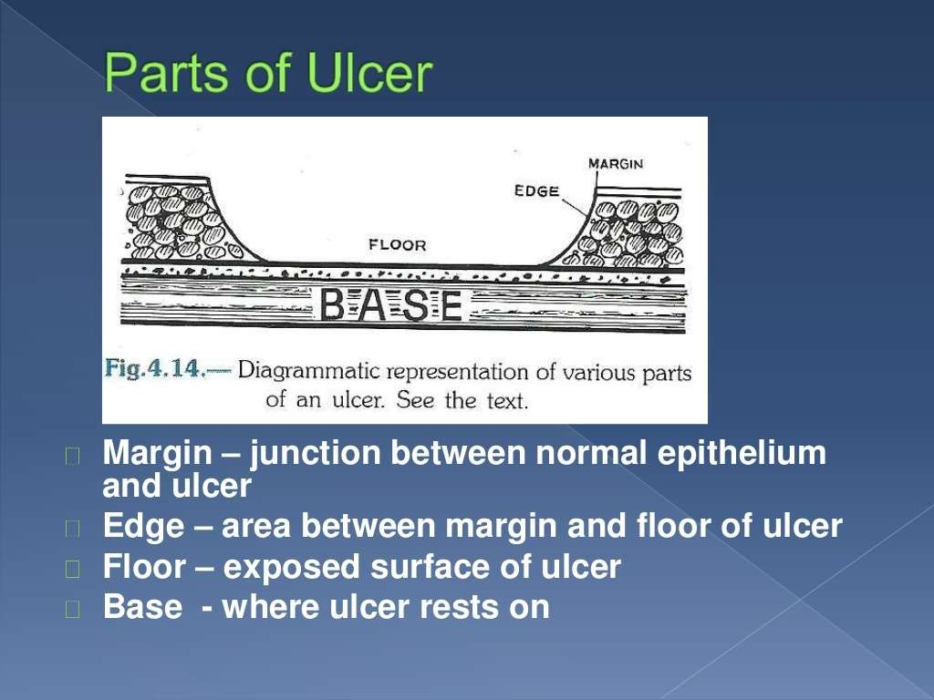

Slide 4

A. Clinical
B. Pathological

Slide 5

 Spreading : (Edge - Inflamed & Edematous)
 Healing : (Edge is sloping with healthy red granulation tissue & serous discharge)
 Callous : (Floor contains pale unhealthy granulation tissue with indurated edge)

Slide 6

1. Nonspecific
2. Specific
3. Malignant

Slide 7

Traumatic Ulcer
Arterial Ulcer
Venous Ulcer
Neurogenic Ulcer
Infective Ulcer

Slide 8

Tuberculosis
Syphilis
Actinomycosis
Meleney’s ulcer
Soft sore

Slide 9

Squamous cell ca
Basal cell ca
Malignant melanoma

Slide 10

 Mode of onset
 Duration
 Pain
 Discharge
 Associated disease

Slide 11

 General survey
 Inspection
 Palpation
 Examination of lymph nodes
 Vascular insufficiency
 Nerve lesions

Slide 12

 SIZE AND SHAPE
 NUMBER
 POSITION
 EDGE
 FLOOR
 DISCHARGE
 SURROUNDING AREA

Slide 13
Arterial ulcer | Tip of the toes, dorsum of the foot
Long saphenous varicosity with ulcer | Medial side of the leg.
Short saphenous varicosity with ulcer | Lateral side of the leg.
Perforating ulcers | Over the sole at pressure points.
Nonhealing ulcer | Over the shin

Slide 14

DEF: This is between the floor of the ulcer and the margin.
The margin is the junction between the normal epithelium and the ulcer.
These two parts represent areas of maximum activity.

Slide 15

All healing ulcers like traumatic ulcers, venous Ulcers
A. Sloping edge

Slide 16

Gummatous ulcers and trophic ulcers.
B. Punched out edge

Slide 17

Tuberculous ulcers
C. Undermined edge

Slide 18

Rodent ulcers or basal cell carcinoma .
D. Raised edge (beaded edge)

Slide 19

Squamous cell carcinoma.
E. Everted edge (Rolled out)

Slide 20

DEF : This is the part of the ulcer which is exposed or
seen.
Red granulation tissue | Healing ulcer
Necrotic tissue, slough | Spreading ulcer
Pale, scanty granulation tissue | Tuberculous ulcer
Wash-leather slough | Gummatous ulcer

Slide 21
Serous discharge | Healing ulcer
Purulent discharge | Spreading ulcer
Bloody discharge | Malignant ulcer
Discharge with bony spicules | Osteomyelitis
Greenish discharge | Pseudomonas infection

Slide 22
Thick and pigmented | Varicose ulcer.
Thin and dark | Arterial ulcer.
Red and oedematous | Spreading ulcers like diabetic ulcer.

Slide 23

 TENDERNESS
 EDGE AND MARGIN
 BASE
 INDURATION
 BLEEDING
 RELATIONS WITH DEEPAR
STRUCTURES
 SURROUNDING SKIN

Slide 24

 Induration (hardness) of the edge is very characteristic of squamous cell carcinoma.
 It is said to be a host defense mechanism.
 Tenderness of the edge is characteristic of infected ulcers and arterial ulcers.

Slide 25

 It is the area on which ulcer rests.
 Marked induration at the base is diagnostic of squamous cell carcinoma.

Slide 26

Maximum induration | Squamous cell carcinoma
Minimal induration | Malignant melanoma.
Brawny induration | Abscess.
Cyanotic induration | Chronic venous congestion as in varicose ulcer.
The edge, base and the surrounding area should be examined for induration.

Slide 27

 Malignant ulcer is friable like a cauliflower.
On gentle palpation, it bleeds.
 Granulation tissue as in a healing ulcer also causes bleeding.

Slide 28
 Thickening and induration is found in squamous cell carcinoma.
 Tenderness and pitting on pressure indicates spreading inflammation surrounding the ulcer.

Slide 29
 REGIONAL LYMPH NODES
Tender and enlarged | Acute secondary infection.
Non-tender and enlarged | Chronic infection.
Non-tender and hard | Squamous cell carcinoma.
Non-tender, large, firm, multiple | Malignant melanoma.

Slide 30
Thank you

